Slide 1
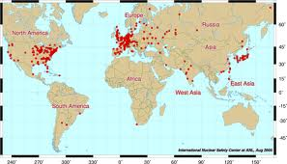
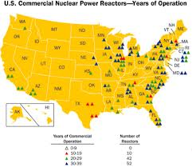
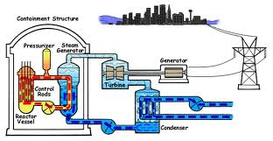
The History of Nuclear Reactors

Slide 2
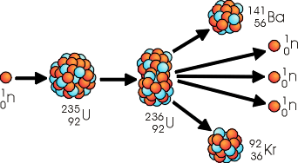
Uranium Fission

Slide 3
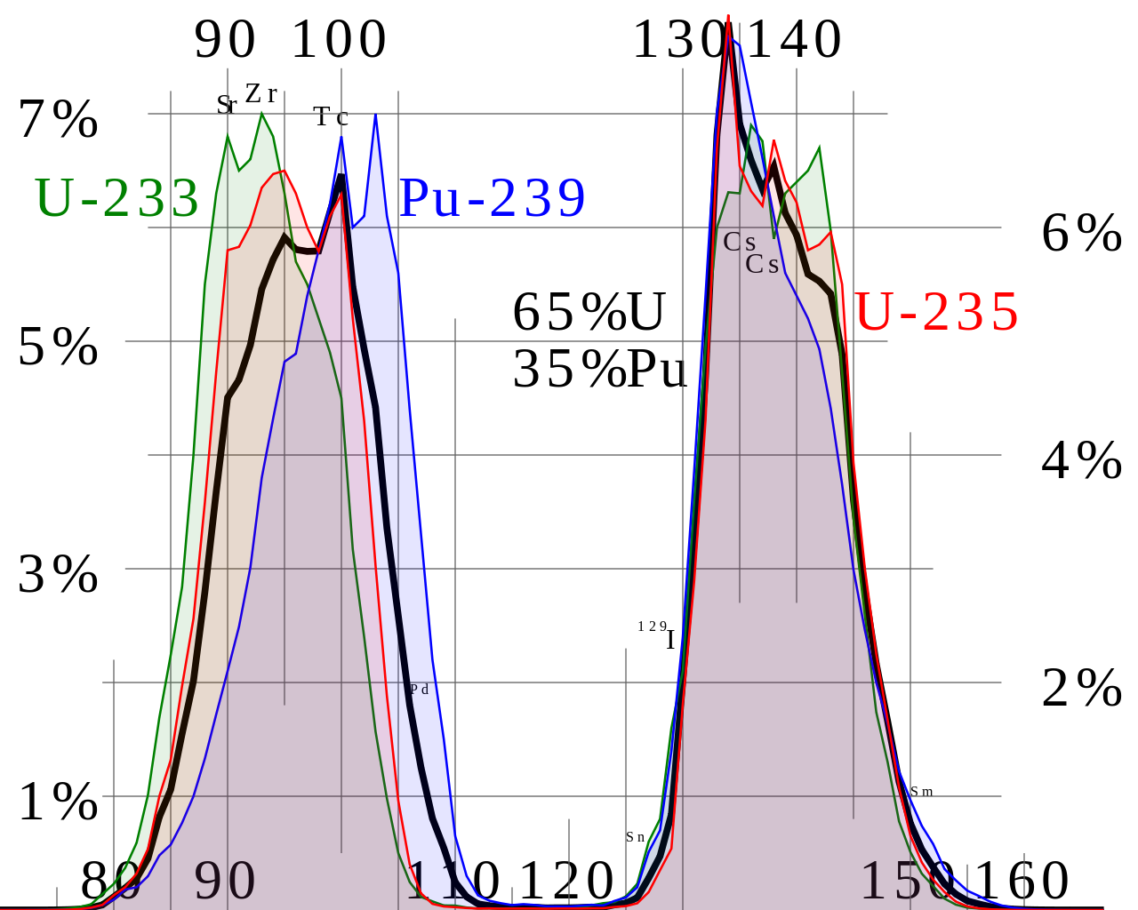
Uranium Fission

Slide 4
Discovery of Nuclear fission in Germany - 1938
Otto Hahn, Fritz Strassmann, Lise Meitner, Otto Frisch
Kaiser Wilhelm Institute for Chemistry
Hahn won Nobel Prize in Chemistry 1944
Contradicted work by Fermi who believed that they were only making elements 93 and 94

Slide 5
Pre-World War II
1939 – Francis Perrin introduced three concepts critical to nuclear reactors:
Moderation (graphite, water, or heavy water)
Critical mass
Absorbing control rods (boron, cadmium)

Slide 6
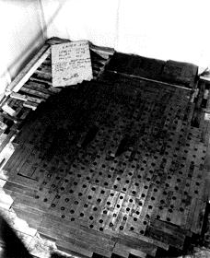
First critical reactor: Fermi’s Pile
December 2, 1942 – Fermi reported having produced the first self-sustaining chain reaction
Beneath the West Stands of Stagg Field (a squash-rackets court) in Chicago

Slide 7
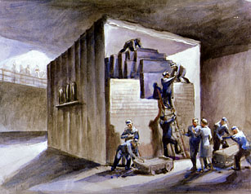
“A crude pile of black bricks and wooden timbers” - Fermi
No cooling system
No radiation shield or containment!
Mixture of natural uranium and graphite bricks
771,000 lbs graphite
81,000 lbs UO
12,000 lbs U metal
½ Watts

Slide 8
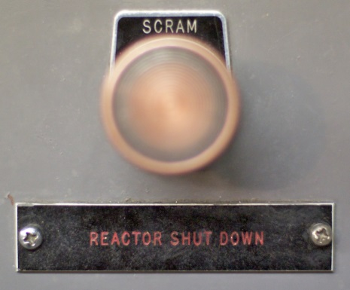
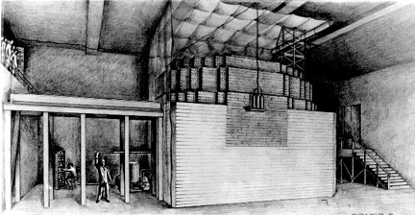
SCRAM!
Safety
Control
Rod
Axe
Man
-
Or is it?

Slide 9
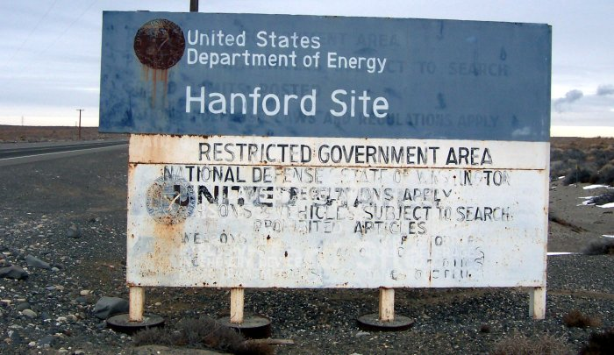
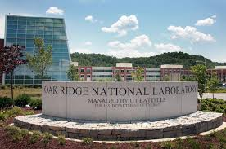
The first Pu production reactors for Manhattan project
Early natural uranium-fueled, water-cooled reactors constructed at Hanford, WA.
As a backup project, the X-10 Pu production reactor of air-cooled design was built at Oak Ridge, Tennessee.

Slide 10
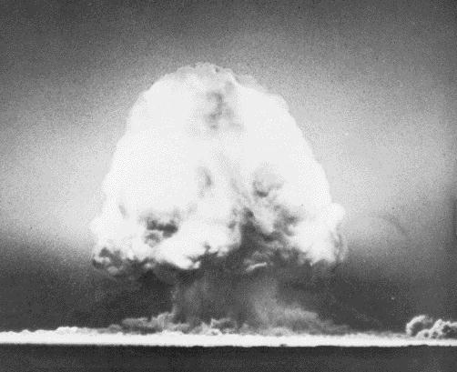
The Trinity Test
July 16, 1945 (5:29:45 AM) – the first nuclear explosive device was tested successfully at Alamogordo, New Mexico
It used plutonium made in a nuclear reactor
The teams did not consider it necessary to test a simpler device using ²³⁵U.

Slide 11
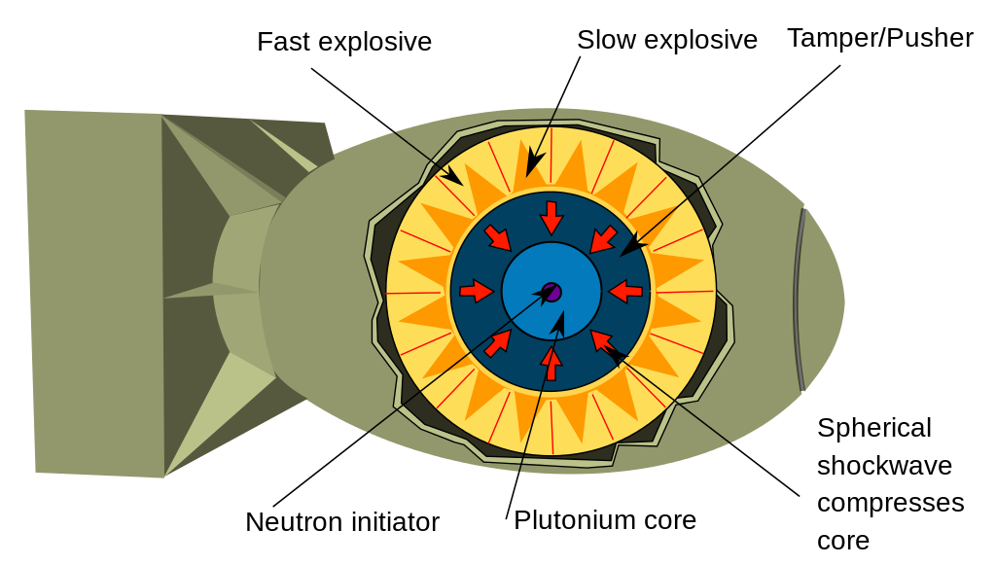
Implosion Device
Well timed explosions increases the density of the Pu core, bringing the atoms closer together to achieve a critical geometry
Fat Man, Trinity

Slide 12
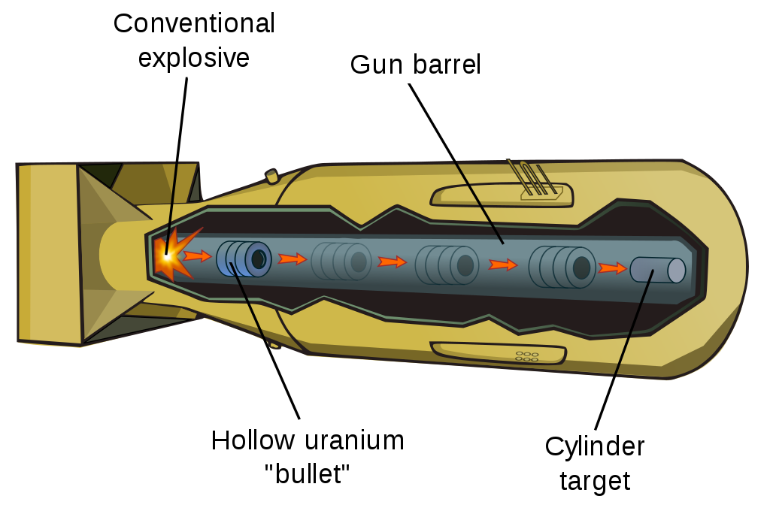
Gun Type
Two subcritical masses of ²³⁵U are collided rapidly to form a dense, critical mass
2% uranium fission
Little Boy

Slide 13
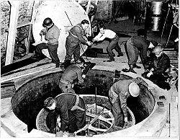
Nazi nuclear pile!
Notes:
-Physicists decided not to mention to Fuhrer out of fear of what would happen if they failed
-Workers fled to US
-US much more coordinated and funded

Slide 14
Post-World War II Era
Shortly after the end of World War II, the first enriched-fuel research reactor (14.6 w/o ²³⁵U) was completed at Los Alamos as enriched ²³⁵U became available for research purposes
At about this time, the Canadian project succeeded in building a zero-power, natural uranium-fueled research reactor, the so-called ZEEP (Zero-Energy Experimental Pile) – Heavy water
Following this, reactor production increased at a staggering pace

Slide 15
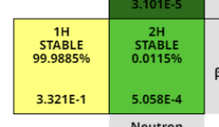
Heavy Water Reactors
²H isotope – Deuterium
Hydrogen with a neutron in the nucleus
D₂O
Water with two deuterium atoms
HDO – Semi heavy water
Not as good at moderating neutrons, but absorbs significantly fewer
Neutron Capture cross section

Slide 16
Early Nuclear Reactors
Name | Location | Operation | Fuel | Moderator
CP-1 | Chicago, IL | Dec 1942 | 50 tons natural U | graphite
X-10 | Oak Ridge, TN | Nov 1943 | natural U cylinders | graphite
CP-3 | Argonne, IL | May 1944 | natural U rods | D₂O
Hanford | Hanford, WA | Sept 1944 | natural U slugs | graphite
LOPO | Los Alamos, NM | Sept 1945 | enriched ²³⁵U, UO₂SO₄ dissolved in H₂O | H₂O
ZEEP | Chalk River, Canada | Sept 1945 | natural U | D₂O
Clementine | Los Alamos, NM | Nov 1946 | ²³⁹Pu rods | none
GLEEP | Harwell, England | Aug 1947 | natural U bars | graphite
NRX | Chalk River, Canada | Aug 1947 | natural U cylindrical rods | D₂O
BSR | Oak Ridge, TN | Nov 1950 | enriched sandwich plates | H₂O
JEEP | Kjeller, Norway | Aug 1951 | natural U rods | D₂O
EBR-I | Arco, Idaho | Dec 1951 | 90% enriched U rods | none
MTR | Arco, Idaho | Mar 1952 | enriched ²³⁵U sandwich plate | H₂O
APS-I | USSR | 1954 | 5% enriched U rods | graphite
PWR | USS Nautilus | Jan 1955 | highly enriched ²³⁵U | H₂O
Calder Hall | Cumberland, England | Oct 1956 | natural U rods | graphite
EBWR | Argonne, IL | Dec 1956 | 1.5% ²³⁵U plates | H₂O
PWR | Shippingport, PA | Dec 1957 | highly-enriched ²³⁵U and natural U | H₂O
Dresden I | Morris, IL | Oct 1959 | enriched ²³⁵U | H₂O

Slide 17
Post-World War II Era (continued)
The earliest U.S. nuclear power project had been started in 1946 at Oak Ridge
the program was abandoned in 1948 to concentrate on the naval reactor program that produced the first nuclear-powered submarine (the Nautilus)
1953 – President Dwight D. Eisenhower of the United States announced the Atoms for Peace program
this program established the groundwork for a formal U.S. nuclear power program and expedited international cooperation on nuclear power

Slide 18

The Nautilus

Slide 19
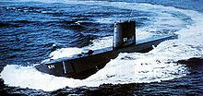
1955: The Nautilus
Reactor designed by Westinghouse
Liquid-metal cooled PWR.
Revolutionized naval warfare.
First sub to have unlimited air conditioning, range, and submerged time!
First submarine to travel underneath the ice to North Pole

Slide 20
Victory of the PWR and BWR
During the late 1950’s and early 1960’s, a number of true commercial prototype nuclear power plants were built
Of these, the most successful were the light-water reactor and pressurized-water reactor systems
Some alternatives:
Fast breeder reactors (perpetual energy machines!?)
Heavy water moderated reactors (Canada CANDU)
High-temperature gas-cooled (HTGR)
Graphite moderated (Soviet style RBMK, Chernobyl!)

Slide 21

Pressurized Water Reactor

Slide 22
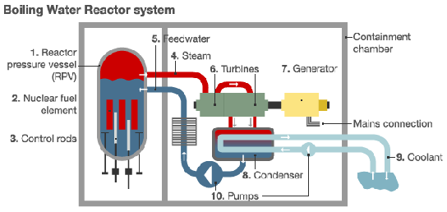
Boiling Water Reactor

Slide 23
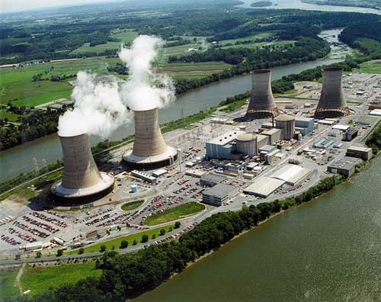
1979: Three Mile Island

Slide 24
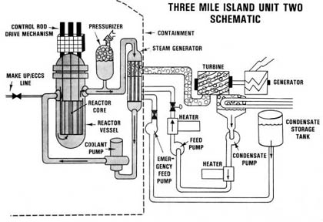
A multiple fault event: who wins: machines or humans?
The feed pump in the turbine loop malfunctioned (Machine Fault 1)
This caused the reactor to SCRAM
Decay heat caused an increase in pressure
A relief valve opened to decrease the pressure
However, the valve failed to close (Machine Fault 2)
The operators incorrectly read the indicator light and thought the valve was properly closed (Human Fault 1)
42 hours prior, workers tested the emergency pump and incorrectly left a valve open causing the emergency pump to not work (Human fault 2)

Slide 25
Multiple faults continued
During the emergency pump maintenance 42 hours prior, it was also NRC regulations to shut down the reactor (not done) so something like this couldn’t happen (Human Fault 3)
So, now the reactor was losing water and pressure due to the faulty valve and getting hotter due to the faulty emergency pump, and the operators thought the reactor was actually GAINING pressure
There was another indicator light which correctly depicted the situation, but it was behind a desk where no one could see it (Human fault 4)
Final tally: Humans: 4 Machines: 2

Slide 26
Aftermath
During the several hours where the operators failed to grasp the situation, 60% of the fuel melted.
Some of this fuel diffused into the coolant water
The pressure relief valve released coolant water out of the containment building to an auxiliary building
Ultimately, about 17 million Curies of gaseous fission products (Xe, I, Kr) was released into the atmosphere
No statistically significant increase in cancer in surrounding area

Slide 27
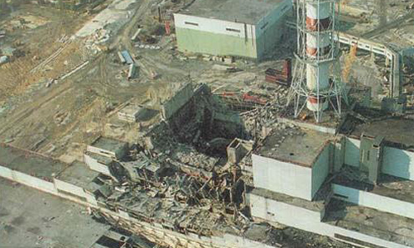
1986 Chernobyl: super-prompt critical incident

Slide 28
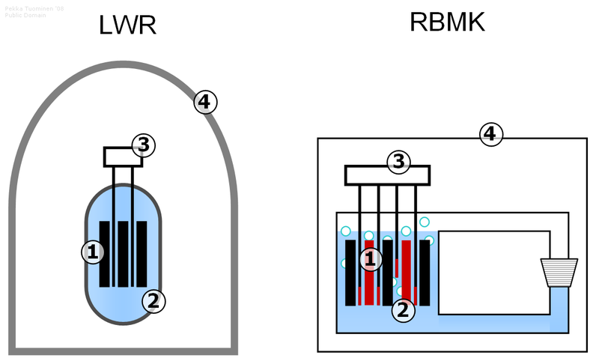
Greedy Soviet design flaws!
1) Graphite moderator w/ water coolant, 2) positive coolant void coefficient, 3) control rods tipped with graphite, 4) no containment building

Slide 29
What went wrong?
A special safety test of the turbine was supposed to take place around 1 pm when electricity demand was low (test called for lowering and increasing power)
An unusually cold Russian day caused the test to be delayed…
11:10 pm: The test and power reduction resumed
12:00 am: Shift change. Now only electrical engineers knew what was going on
The electrical engineers then attempted to raise the power levels

Slide 30
What went wrong continued
But fission-product poisons caused the reactor to take a long time to increase power
To speed up this process, they started to withdraw control rods:
Operating procedure: always leave at least 30 rods inserted
They had 205 rods withdrawn and only 6 rods inserted
Suddenly power began to rise rapidly
The emergency control rods were lowered and the sudden introduction of the graphite tips caused the reactor to go super-prompt critical
Power was at 300,000 MW
Two thermal explosions

Slide 31
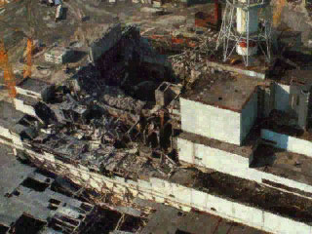
Summary of Facts
April 26, 1986:
Chernobyl nuclear power plant
Operator errors cause a reactor explosion
Explosion releases 190 tons of radioactive gasses into the atmosphere
Fire starts that lasts 10 days
People:
7 million lived in contaminated areas; 3 million were children
Wind:
Carries radiation far distances

Slide 32
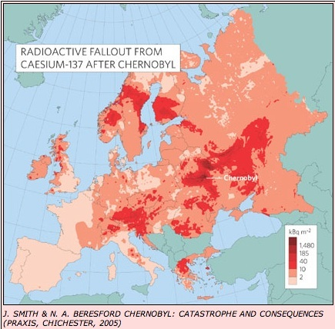
Radioactive fallout

Slide 33
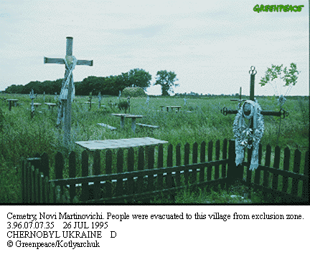
Human Impact
5.5 million people still live in contaminated areas
31 people died in 3 months of radiation poisoning
134 emergency workers suffered from acute radiation sickness
Cancer afflicts many others: estimates of cancers attributable to Chernobyl range from ~5,000 to 20,000 (vast majority are thyroid cancers)

Slide 34
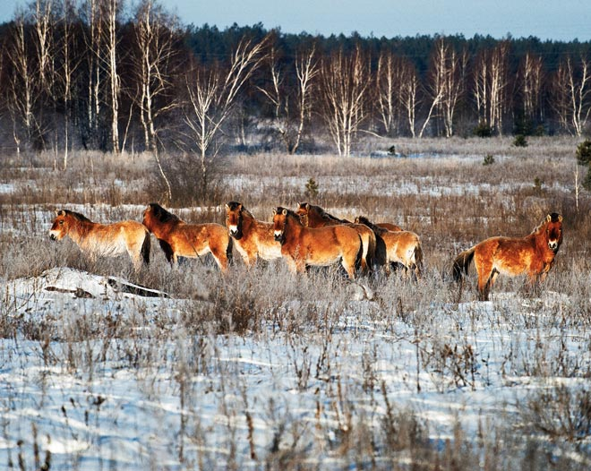
Environmental impact: wildlife paradise?

Slide 35
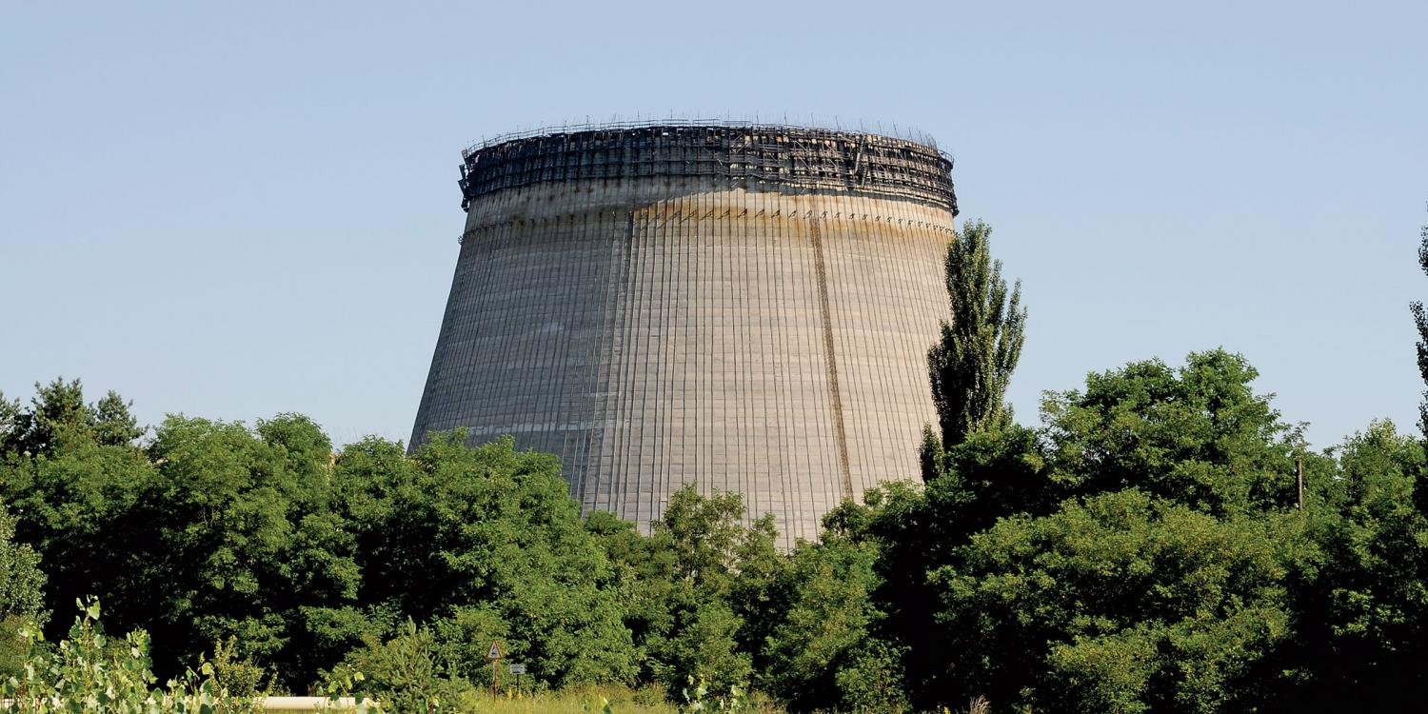

Slide 36
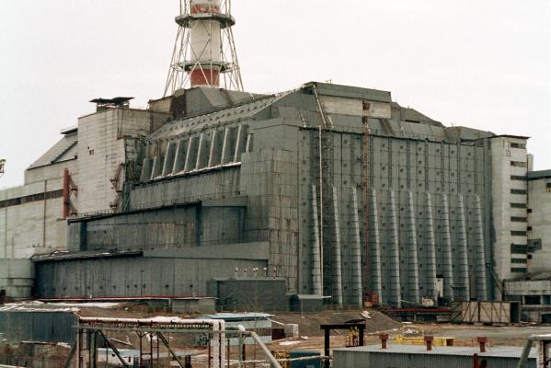
Old sarcophagus

Slide 37
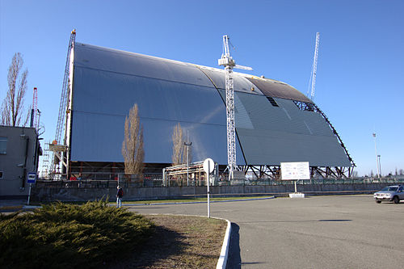
New sarcophagus

Slide 38
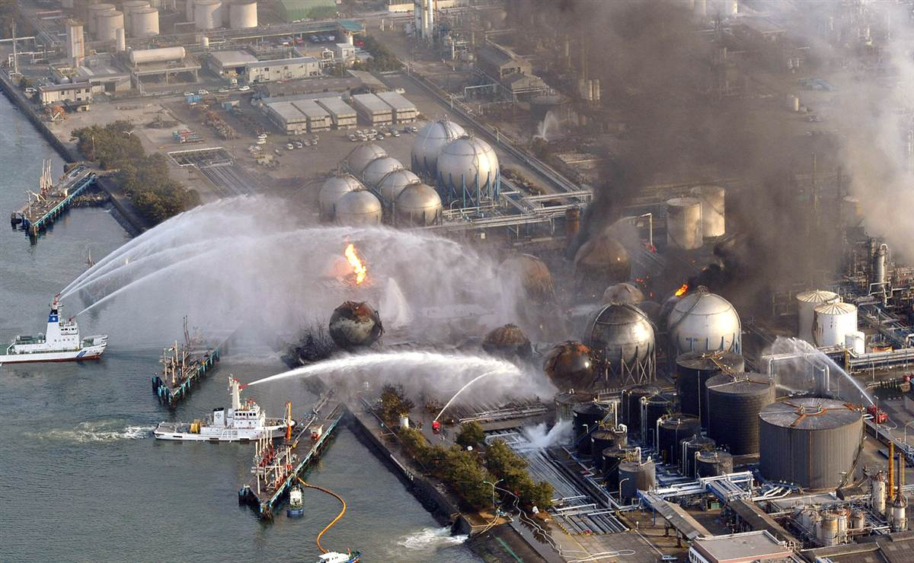
Fukushima

Slide 39
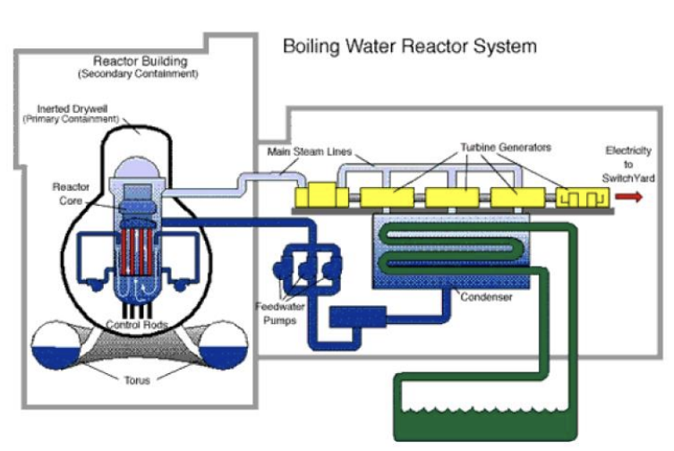
Fukushima
March 11th, 2011
Large earthquake (9.0) off coast of Japan
BWR Style Reactor

Slide 40
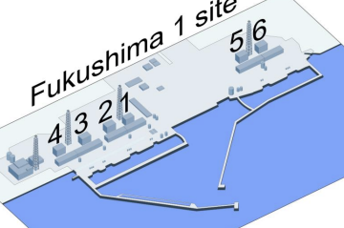
Fukushima
3 backup power systems failed to run cooling system pumps
Knocked out off site power
Flooded emergency diesel generators
Batteries eventually died
1,2,3 operating
4 offline and defueled
5 and 6 cold shutdown

Slide 41
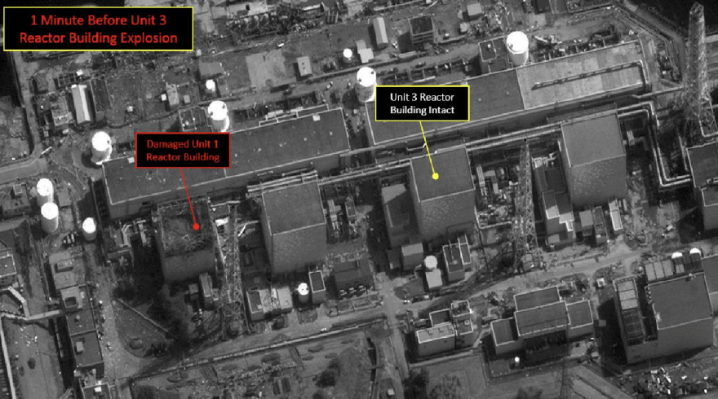
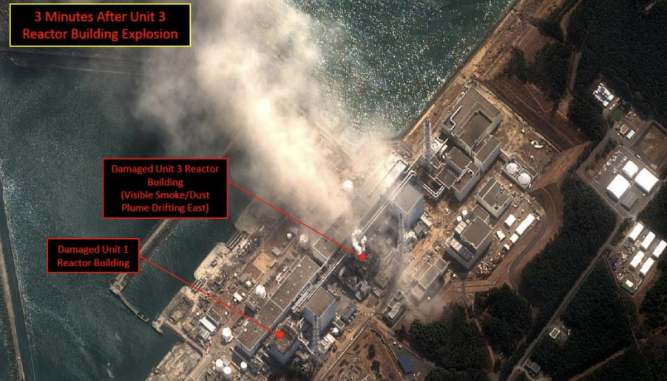
Fukushima
March 12th
Hydrogen explosion in reactor 1 destroys building, exposing spent fuel pools
Zr + 2H₂O -> ZrO₂ + H₂ at high temperatures
March 14th
Reactor 3 hydrogen explosion
March 15th
Reactor 2 hydrogen explosion

Slide 42
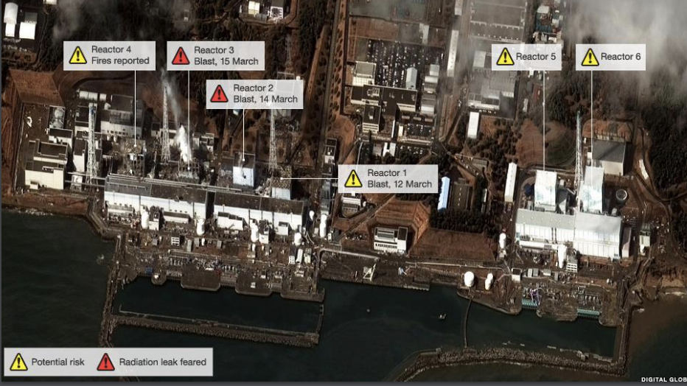
Fukushima
March 16th
Efforts to maintain spent fuel pool temperatures are main effort, seawater used
Containments still in place for reactor

Slide 43
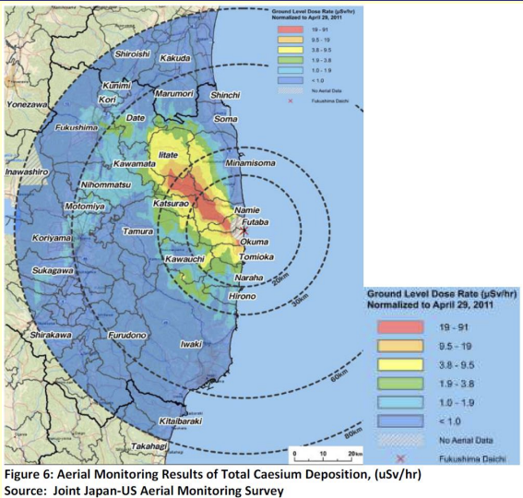
Fukushima Effects
No direct fatalities due to radiation
Long term cancer effects estimated to impact 130-640 people
1,600 deaths due to the poor evacuation plans
April 29th, 2011

Slide 44
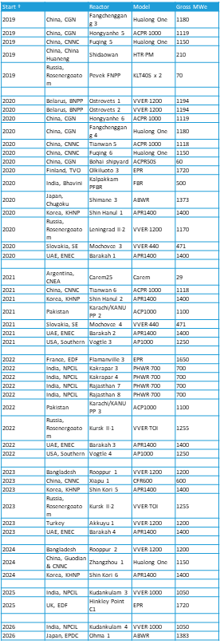
New Nuclear Power Plants

Slide 45
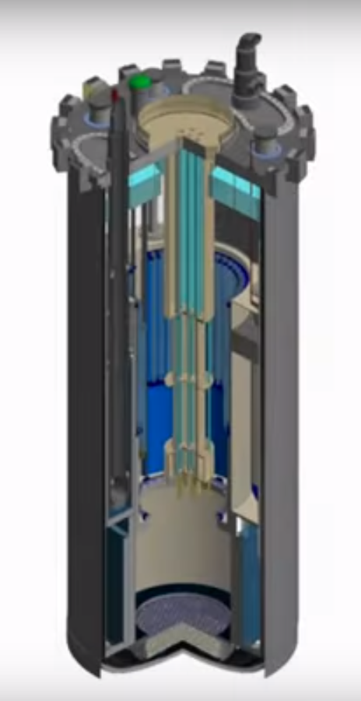
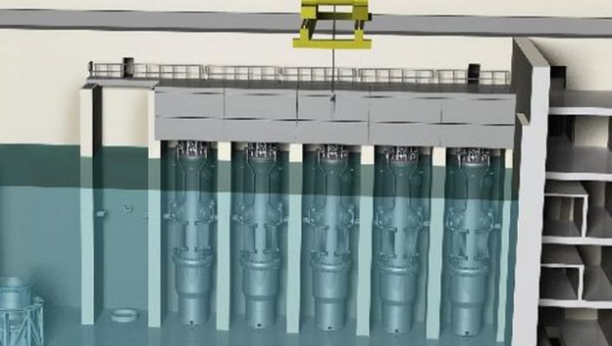
Advanced Reactors
VTR
NuScale
NuScale, LLC
US DOE

Slide 46
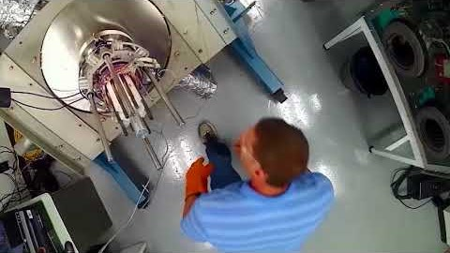
Nukes in Space!

Slide 47
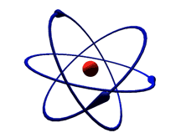





How Nukes Work

Slide 48
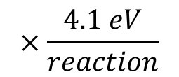
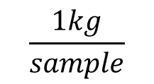
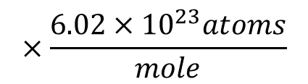
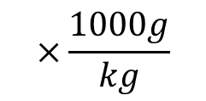
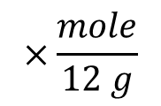
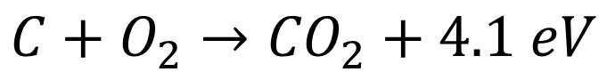
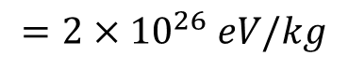
$$C+O_{2}→{CO}_{2}+4.1 eV$$
for 1 kg of coal, assuming 100% C,
$$\frac{1kg}{sample}$$
$$×\frac{mole}{12 g}$$
$$×\frac{1000g}{kg}$$
$$×\frac{6.02×{10}^{23}atoms}{mole}$$
$$×\frac{4.1 eV}{reaction}$$
$$=2×{10}^{26} eV/kg$$

Slide 49
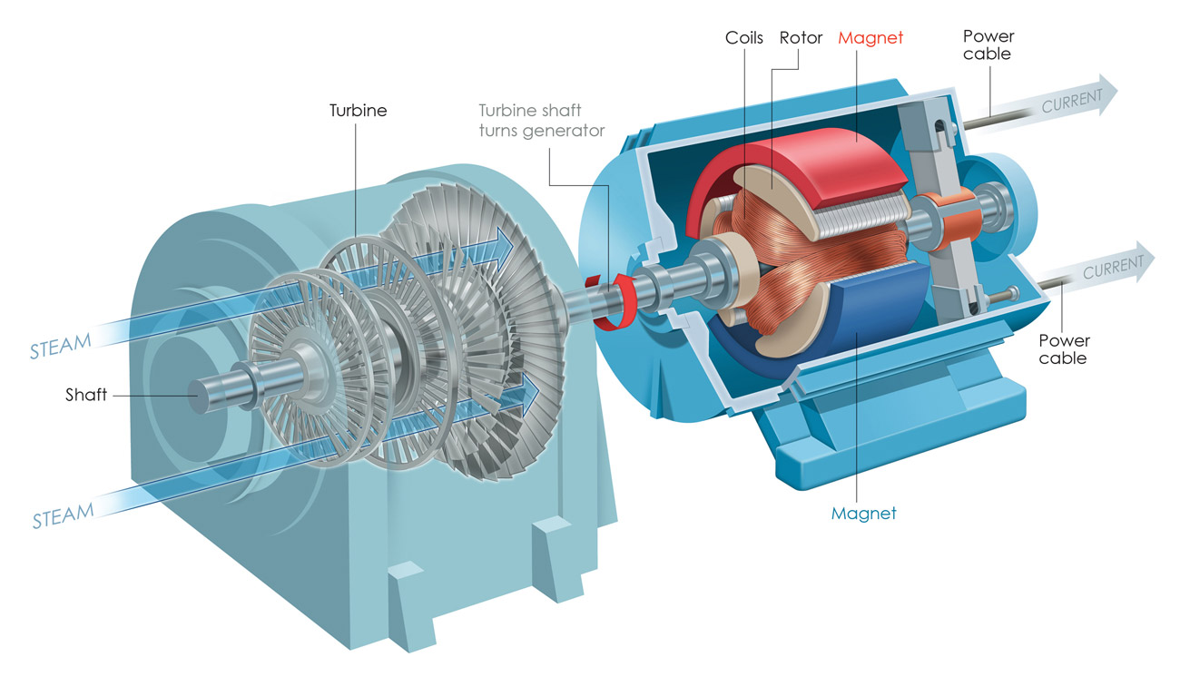
https://i.pinimg.com/originals/87/dc/45/87dc450874b56fb68ce0586ca5c8e147.jpg

Slide 50
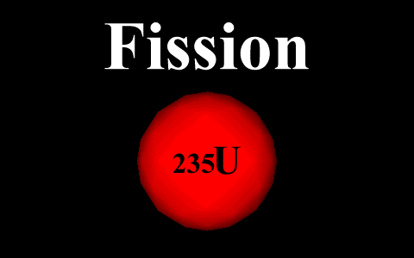

Slide 51


Slide 52













$${}_{}^{235}{U+n→{}_{}^{135}{Xe}+{}_{}^{99}{Mo}+2n+200 MeV}$$
for 1 kg of uranium, assuming 0.72% ²³⁵U,
$$\frac{1kg ×0.0072}{sample}$$
$$×\frac{mole}{238 g}$$
$$×\frac{1000g}{kg}$$
$$×\frac{6.02×{10}^{23}atoms}{mole}$$
$$×\frac{200 MeV}{reaction}$$
$$=4×{10}^{30}eV$$
$$/kg$$
or if we assume use in an advanced reactor:
$$\frac{1kg}{sample}$$
$$×\frac{mole}{238 g}$$
$$×\frac{1000g}{kg}$$
$$×\frac{6.02×{10}^{23}atoms}{mole}$$
$$×\frac{200 MeV}{reaction}$$
$$=5×{10}^{32}eV/kg$$
(1 kg coal $=2×{10}^{26} eV/kg$)

Slide 53


Slide 54
www.nrc.gov

Slide 55

http://www.world-nuclear.org/uploadedFiles/org/WNA/Publications/Working_Group_Reports/comparison_of_lifecycle.pdf

Slide 56
Dispatchable
Non-Dispatchable
Natural Gas
$16B*

Slide 57


Slide 58


Slide 59


Slide 61


World supply is 150,000 TWh/y
https://www.nextbigfuture.com/2012/06/deaths-by-energy-source-in-forbes.html

Slide 62


Slide 65

Ye shall know the truth and the truth shall set you free

Slide 66
How Nukes Work
How is nuclear power different from chemical power sources?
How do nuclear power plants generate electricity?
Isn’t nuclear power / waste dangerous?
What about the risk of nuclear weapons?
Union of Concerned Scientists: https://www.ucsusa.org/nuclear-power/cost-nuclear-power/retirements?_ga=2.68367313.1717052947.1542400265-1929339798.1542306463#.W-8pJ-hKiUk
Bill Nye on Fukushima: https://www.youtube.com/watch?v=bcXf6aWt4hI
John Oliver on nuclear waste: https://www.youtube.com/watch?v=ZwY2E0hjGuU
Iran deal: https://www.youtube.com/watch?v=oqvghou5m3U
Monitoring for nuclear tests: https://www.youtube.com/watch?v=daZ7IQFqPyA

